Slide 1

Text Analysis I
Day 1
Namig Abbasov, PhD
Digital Humanities Analyst

Slide 2
What is Text Analysis?
Text analysis(aka text mining or text analytics) is the process of deriving meaningful information from natural language text, e.g. human generated text
Transform unstructured text data into structured data
Process text-based sources including articles, books, book chapters, emails, messages, various kinds of documents, social media content, and product reviews etc.
Identify patterns, relationships, sentiments, topics etc.

Slide 3
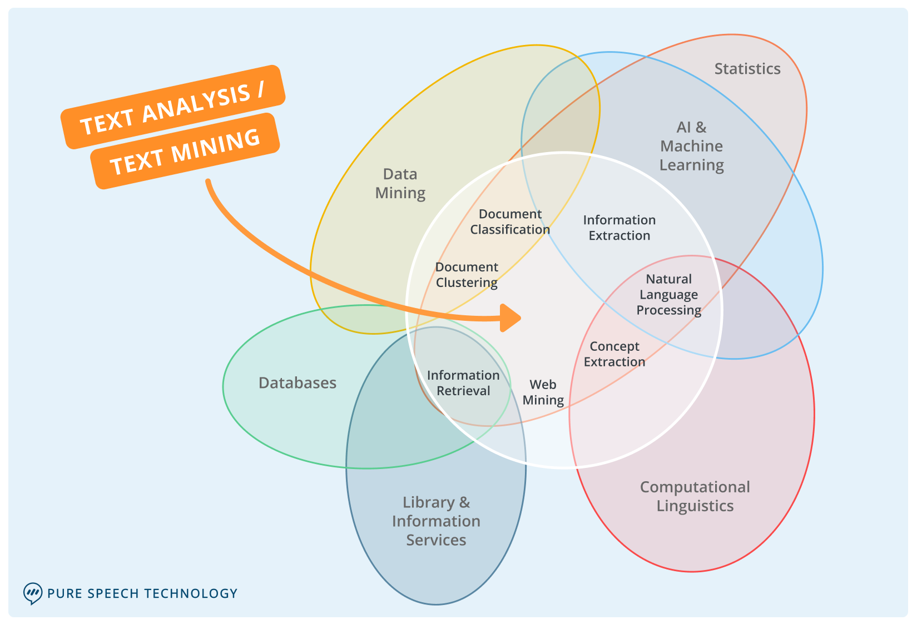
Intersection of Text Analysis with Other Fields
Text Analysis/Text Mining
process of deriving meaningful information from unstructured text
Data Mining
Classification, pattern discovery (overlap with unsupervised ML)
Statistics
Artificial Intelligence
Enable machine to think and act like humans: Rule-based vs ML
Machine Learning
ability to “learn” from data without being explicitly programmed​
Databases
Designed to manage, store, and retrieve data: relational, NoSQL
Library and Information Services
managing libraries and providing access to information. ​
Computational Linguistics
Data mining on social media
Use larger raw data(both un- and structured) to generate new info
Text analysis could be both rule-based and ML ​
Text retrieval, text mining integration
develops computational methods to answer the scientific questions of linguistics
Notes:
- At the core of data mining lies the use of a larger raw data, both structured and un-structured to discover patters, make prediction, visualizations, classifications etc. It also includes Database Querying and Data Warehousing. Text analysis is used for data mining(social media data).
Text analysis could be rule-based as well. NoSQL(not only SQL) data bases emerged a response to the limitations of relational data.
Information Retrieval is about developing, managing, and improving systems that users employ to find information, often within digital databases or the internet. This involves digital libraries.
computational linguistics is a more theoretical field, while NLP is a more applied field that builds on the insights gained from computational linguistics to develop practical tools and applications.

Slide 4
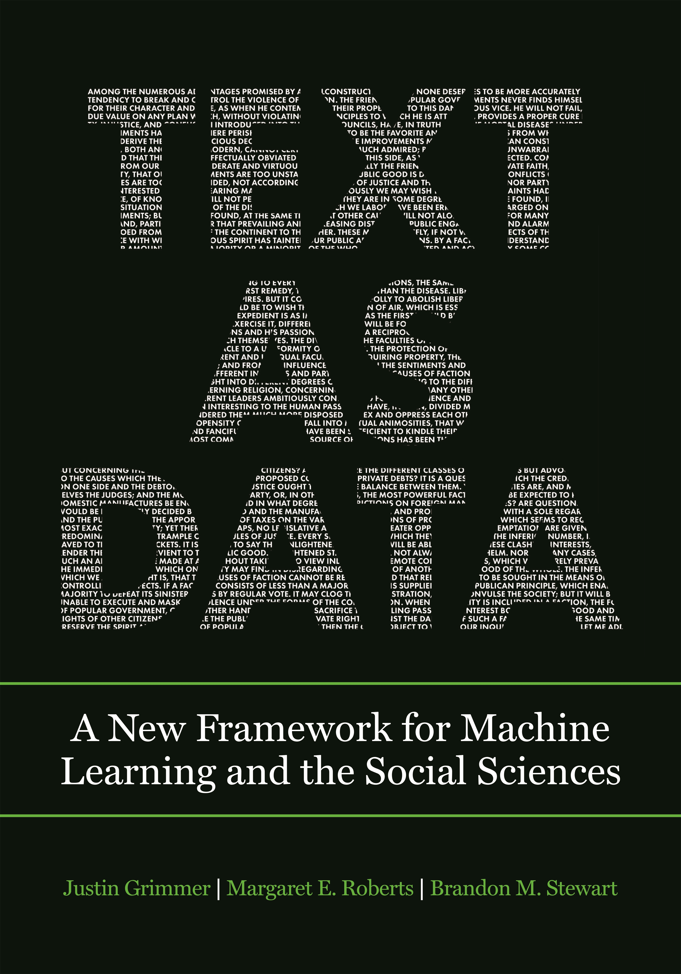
Key Principles of Text Analysis
Domain knowledge is essential for research design
Combine data, algorithms, and substantive knowledge
Text analysis does not replace humans
it augments them.
Building, refining, and testing theories require iteration and cumulation
Text analysis methods distill generalization from language
Reduce dimensionality: interpretation, overfitting,
The best method depends on the task.
Pragmatic, task-specific approach: topic modeling better in newspapers/speeches than informal language
Validations are essential
depend on the theory and the task.

Slide 5

Why do We Need Text Analysis?
Information flood
Navigate massive amounts of text data
Interconnected Internet
Comprehend content’s meaning rather than just content itself.
Personalized Content
Comprehend user preferences, delivering personalized content
Advancing AI with Text:
Train ML algorithms , chatbots, automated customer service
Web Search
Power algorithms behind search engines

Slide 6
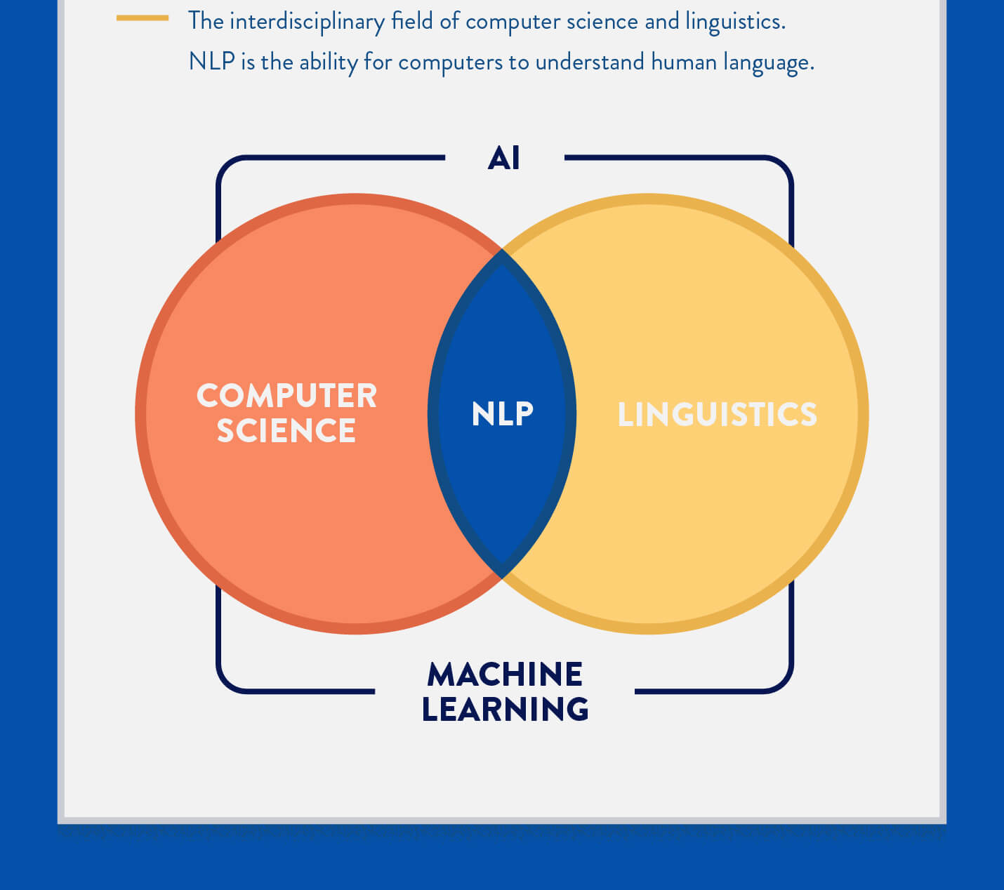
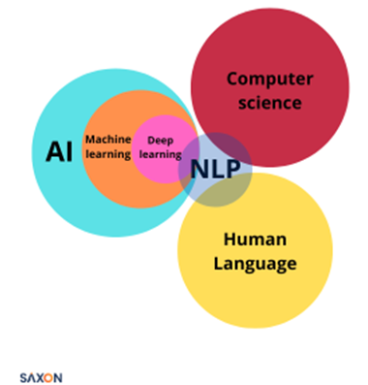
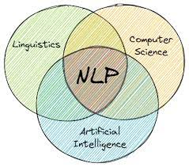
Natural Language Processing

Slide 7

NLP and Deep Learning: Large Language Models(LLMs)
Recurrent Neural Networks (RNN)
Vanishing and exploding gradient problems
Long Short-Term Memory (LSTM)
Gated Recurrent Units (GRU)
Transformer Architecture
“Attention is all you need”

Slide 8

Transformer Architecture Revolutionized Language Processing
Self-Attention Mechanism
Parallel Processing
PaLM
GPT
Layered Structure

Slide 9
Text Analysis vs Natural Language Processing(NLP)
Natural Language Processing
intersection of computer science, artificial intelligence, and linguistics
Related but different
Part of NLP: Text analysis use NLP methods
could be ML- or rule-based
allow computers to understand, process, and generate human language meaningfully
two important steps
natural language understanding
natural language generation

Slide 10

Steps in Text Analysis
Data Collection ​
Preprocessing​
Text Vectorization
Modeling/Analysis ​
Evaluation​
Text Representation​
Text Preprocessing

Slide 11
Data Collection ​
What is the goal of text analysis?
What techniques: e.g. sentiment, topic modeling
Objectives will guide data collection strategy
What are potential data sources?
websites, social media platforms, online forums, databases, news articles, research papers, books, customer reviews, survey responses
How can I collect them?
Web scraping
APIs
Bulk Download
Manual
OCR

Slide 12
Data Preprocessing
Tokenization​
Normalization​
Handling misspellings​
POS (Part-Of-Speech) Tagging
Cleaning Redundant
Removing Special Characters
Sequence padding
Punctuation removal
Number removal
Lowercasing
Stemming/Lemmatization
Stopword Removal
Infrequent Word Removal
N-grams

Slide 13

Punctuation Removal
Default: remove all special punctuations and special characters
.: ” ;,$, %, &, etc
Uninformative
Need to be careful about research goals
For instance, Twitter hashtags

Slide 14

Number Removal
Mostly uninformative
But need be careful about corpus content
Section numbers in a corpus of Congressional bills (e.g. “Section 234”)

Slide 15
Lowercasing
Most of the time, lowercasing the first letter of a word doesn’t alter its significance.
beginning of sentence vs end of sentence
Yet, there are occasions when a word, despite having identical spelling, can convey distinct meanings.
“march” vs “March”
The soldiers began to march toward the horizon.
Her birthday is in March.
“may” vs “May”
You may go out after finishing your homework.
The flowers bloom in May.
“polish” vs “Polish”
I will polish the silverware for the dinner party.
She is learning to speak Polish.

Slide 16
Stemming/Lemmatization
Lemmatization
dictionary form
computationally expensive
Stemming
root: coming, comes ➔come
easy to do
Both reduce dimensionality substantially.

Slide 17
Stopword Removal
Some words, referred to as “stop words”, convey little information.
“it, I, to, thus, the, a ..”
no single gold-standard list of English stopwords
default stopword list by software
However, need to be careful about research goals
Federalist papers by Alexander Hamilton, James Madison, and John Jay

Slide 18
Infrequent Word Removal
A rule of thumb: remove terms that appear in less than 0.5%–1% of documents
Rationale
Theoretically
looking for patters
Less contribution to patters
Practically
Reduce size of vocabulary
Speed-up analysis

Slide 19
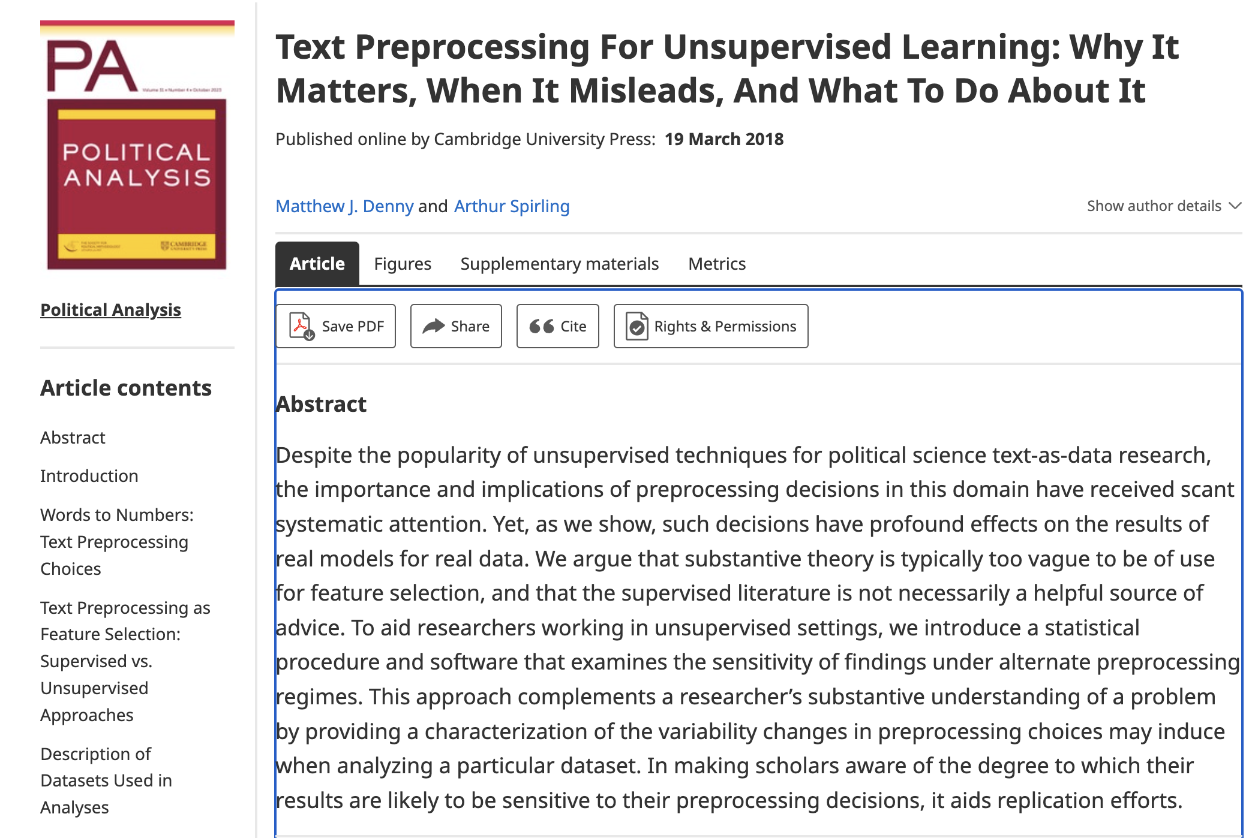
N-grams Inclusion
Advantage: better insights from text
“National defense”, “National debt”, “United States”
Disadvantages: dimensionality

Slide 20
Seven Total Binary Preprocessing Decisions
Punctuation removal
Number removal
Lowercasing
Stemming
Stopword removal
Infrequent term removal
N-gram inclusion
That is 128 possible DFM specifications!

Slide 21
Text Vectorization: Putting Text into Structure Data
Vectorization / Transformation Types
Bag of Words (BoW)
Term Frequency-Inverse Document Frequency (TF-IDF)
Word Embeddings (like Word2Vec or GloVe)
Document Term Matrix/Document Feature Matrix
Vectorization / Transformation
converts text from its original form into a format that is more suitable for analysis

Slide 22
Bag of Words Model
Corpus
Document 1: : "I love apples." Document
Document 2: "She loves oranges." Document
Document 3:: "I love oranges and apples.”
Tokenized Corpus
Document 1: ["I", "love", "apples"]
Document 2: ["She", "loves", "oranges"]
Document 3: ["I", "love", "oranges", "and", "apples"]
Love[3], apple[2], orange[2]
Stemming
Stopword Removal
"apples" becomes "apple" etc.
removes "I, she, and"
Bag of Words

Slide 23
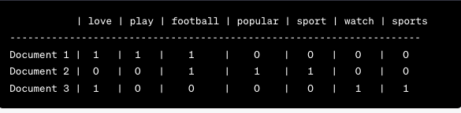
Document Term Matrix/Document Feature Matrix(DFM)
Doc 1: "I love to play football."
Doc 2: "Football is a popular sport."
Doc 3: "I love to watch sports."
Rows represent documents.
Columns represent unique terms
Cells represent term frequencies.

Slide 24
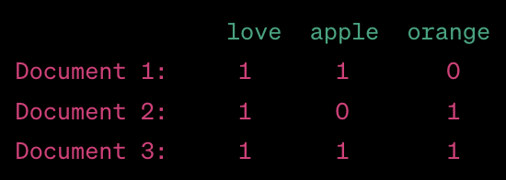
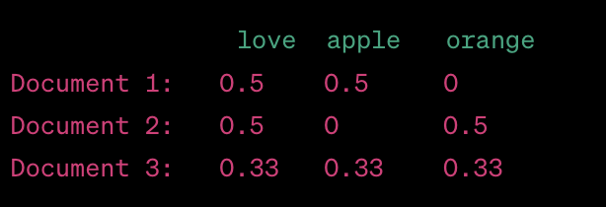
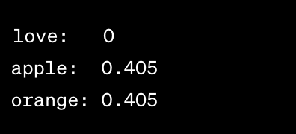
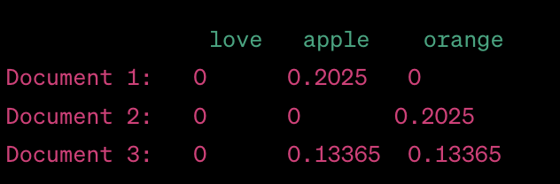
Create Document Feature Matrix(DFM)
Bag of Word Representation in DFM: Count-Based Term Frequency
Proportional Term Frequency (Normalized TF)
Term Frequency-Inverse Document Frequency(TF-IDF)
Inverse Document Frequency (IDF)

Slide 25
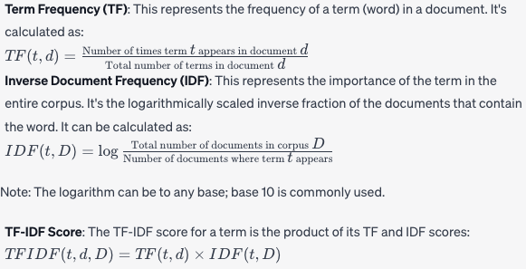

Slide 26
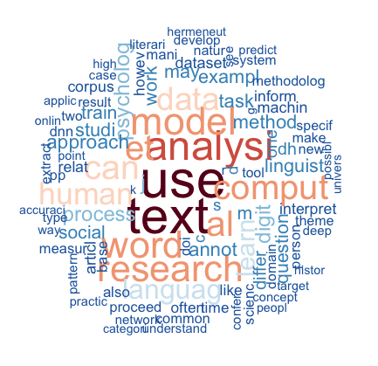
Exploratory Data Analysis (EDA)
Identify patterns, trends, or anomalies
word clouds
bar charts
frequency distributions
Key Word in Context

Slide 27
Modeling/Analysis ​
Rule-Based Based
Dictionary-based method
Sentiment Analysis Using Lexicons
Machine Learning
Supervised Machine Learning
Classification and regression algorithms
Unsupervised Machine Learning
Topic Modeling
Semisupervised Machine Learning
KeyATM

Slide 28

Modeling/Analysis Techniques ​
Text Classification
Topic Modeling
Named Entity Recognition (NER)
Sentiment Analysis

Slide 29
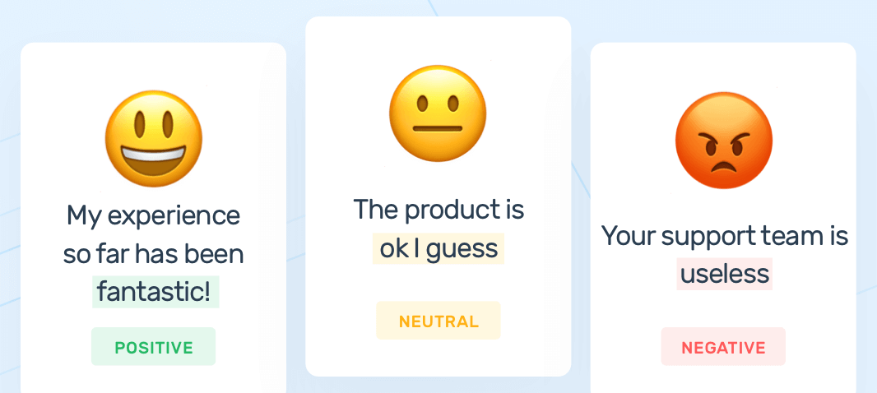
Sentiment Analysis
Determine emotional tone of document
Positive
Negative
Neutral.
Applications
Product reviews, brand monitoring, campaign performance, social media monitoring etc.

Slide 30
Techniques in Sentiment Analysis
Machine Learning Approaches
Lexicon-based Approaches
Hybrid Approaches
Deep Learning

Slide 31
Sentiment Analysis in SS and DH Research
Political Science
Public Opinion
Communication Studies
reactions to a public health campaign on social media
Sociology
Social Movements
Cultural Studies
Sentiments in Cultural texts
Psychology
Mental Health

Slide 32
Topic Modeling
Latent Topics: hidden thematic structures in a text collection. Topic modeling aims to reveal these topics.
Document-Topic Distributions: Each document can be described by a topic distribution
Topic-Word Distributions: Each topic can be described by a word distribution
TM Techniques:
Latent Dirichlet Allocation (LDA): assumes each document is a mix of topics and a topic is a mix of words.
Non-Negative Matrix Factorization (NMF): decomposes the provided document-term matrix into two matrices of smaller dimensions – one symbolizing the documents and the other symbolizing the terms.
Latent Semantic Analysis (LSA or LSI): Employs singular value decomposition (SVD) on the document-term matrix to discern patterns and connections between terms.

Slide 33

Named Entity Recognition (NER)
Information extraction technique
Classifies named entities into predefined categories
person names
organizations
Locations
percentages
How NER works?
Detect a named entity
Categorize the entity
Example: "Apple Inc. is planning to open a new store in New York by 2023.”
"Apple Inc.”: Organization
"New York" : Location
"2023" : Time entity

Slide 34

Performance Evaluation
Preprocessing
preText
Classification: Confusion Matrix
Accuracy
Precision
Recall
Specificity
F1 Score
Regression Tasks
Mean Absolute Error (MAE)
Mean Squared Error (MSE)
Root Mean Squared Error (RMSE)

Slide 35
Applications of Text Analysis
Search Engines
information retrieval
Health Monitoring
patient records, health forums, and social media
Recommendation Systems
Email Filtering
Automatic Translation
Google Translate
Chatbots and Customer Support
Finance and Market Analysis
Academia
Netflix, Amazon, Spotify
filter out spams, categorize emails
market trends, stock price movements, economic shifts
answer user queries, book appointments, or troubleshoot problems
research

Slide 36
Can I rely on Results from My Text Analysis?
What is the purpose of my analysis?
Sentiment analysis on product reviews vs medical diagnoses
How good is my model?
Model accuracy, used algorithms,
How good is my data?
Errors, representativeness etc.
How much have I reviewed the process?
Human review is key for nuances and subtleties!
How much iterative process have results gone through?
Initial results, further analysis, adjust parameters
What performance evaluations have I used?
preText

Slide 37
Challenges for Text Analysis
Sarcasm and Irony
Idioms and Phrasal Verbs
Large Data Volumes
Sparse matrix- Scalability
Data Privacy and Ethics
Ambiguity and Polysemy

Slide 38
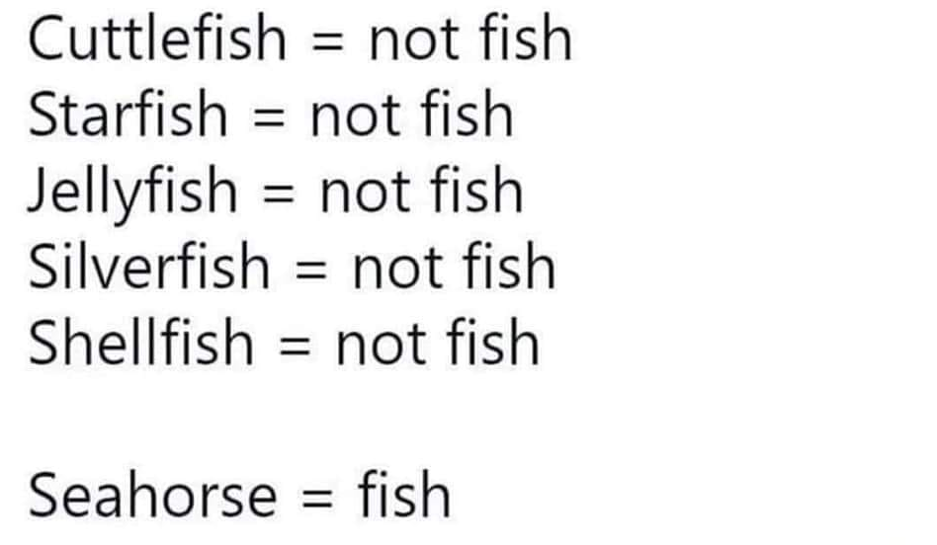
In A Word: Human Language is So Complex!

Slide 39

Thank you for your attention!
Questions or comments?

